Slide 1
Machine Learning

Slide 2
Upon completion of this course, you will be able to:
Master the learning algorithm definition and machine learning process.
Know common machine learning algorithms.
Understand concepts such as hyperparameters, gradient descent, and cross validation.

Slide 3
Machine Learning Definition
Machine Learning Types
Machine Learning Process
Other Key Machine Learning Methods
Common Machine Learning Algorithms
Case Study

Slide 4

Machine Learning Algorithms (1)
Machine learning is a core research field of AI, and it is also a necessary knowledge for deep learning. Therefore, this chapter mainly introduces the main concepts of machine learning, the classification of machine learning, the overall process of machine learning, and the common algorithms of machine learning.
Machine learning (including deep learning) is a study of learning algorithms. A computer program is said to learn from experience $E$ with respect to some class of tasks $T$ and performance measure $P$ if its performance at tasks in $T$, as measured by $P$, improves with experience $E$.
Data
(Experience E)
Learning algorithms
(Task T)
Basic understanding
(Measure P)
Notes:
Deep learning is a specific branch of machine learning. To understand deep learning well, one must have a solid understanding of the basic principles of machine learning.
Task $T$: how the machine learning system should process a sample. A sample is a collection of features that have been quantitatively measured from some objects or events that we want the machine learning system to process, such as classification, regression, and machine translation.
Performance measure $P$: evaluates the abilities of a machine learning algorithm, such as accuracy and error rate.
Experience $E$: Most machine learning algorithms can be understood as being allowed to experience an entire dataset. Some machine learning algorithms do not just experience a fixed dataset. For example, reinforcement learning algorithms interact with an environment, so there is a feedback loop between the learning system and its training process. Machine learning algorithms can be broadly categorized as unsupervised or supervised by what kind of experience they are allowed to have during the learning process.
To learn the game of Go:
Experience $E_{1}$: playing with itself — Unsupervised and indirect learning
Experience $E_{2}$: inquiring humans when playing with itself — Semi-supervised learning
Experience $E_{3}$: historical human games — Supervised and direct learning
Handwritten text recognition: Task $T$: recognizes handwritten texts. Performance measure $P$: classification accuracy. Experience $E$: classified example library (supervised and direct learning).
Robots' desire to advance: Look for new games and practice their skills through tiny changes in the same situation, enriching their training examples.

Slide 5
Machine Learning Algorithms (2)
Experience
Historical data
Induction
Training
Input
Prediction
Input
Prediction
New problems
Future
New data
Future attributes
Regularity
Model

Slide 6
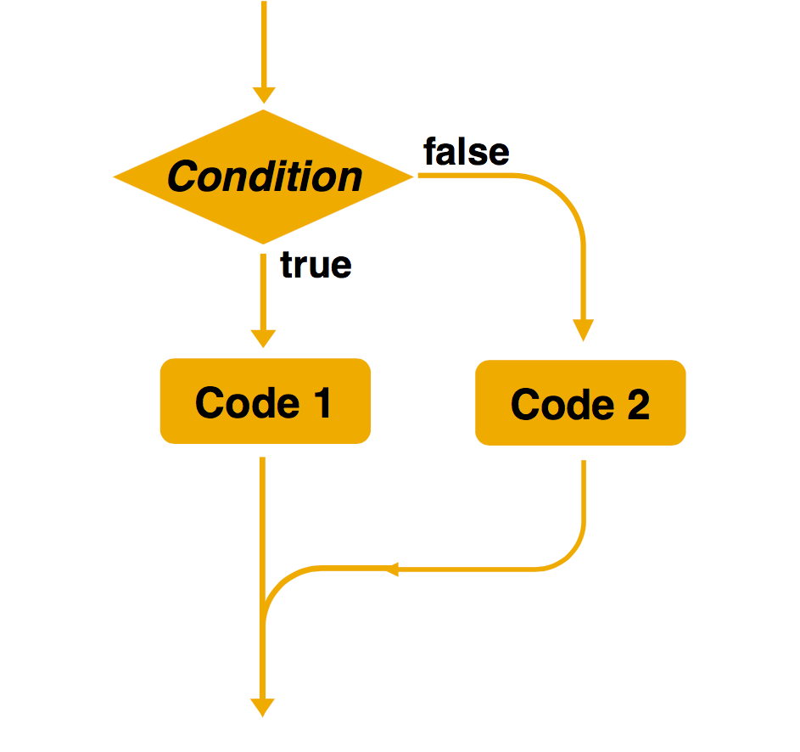
Differences Between Machine Learning Algorithms and Traditional Rule-Based Algorithms
Created by: Jim Liang
Rule-based algorithms
Machine learning
Training data
Machine learning
New data
Model
Prediction
Samples are used for training.
The decision-making rules are complex or difficult to describe.
Rules are automatically learned by machines.
Explicit programming is used to solve problems.
Rules can be manually specified.

Slide 7
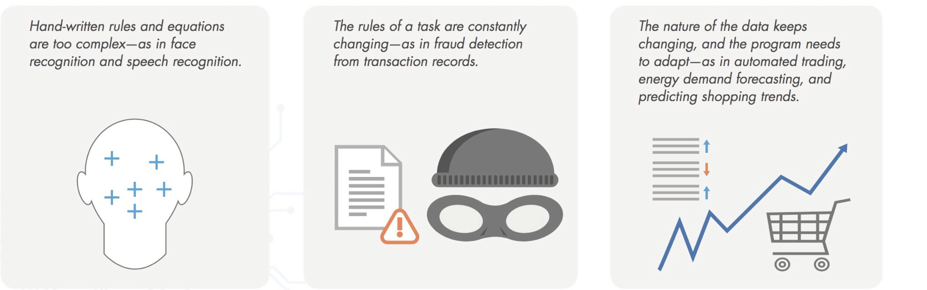
Application Scenarios of Machine Learning (1)
The solution to a problem is complex, or the problem may involve a large amount of data without a clear data distribution function.
Machine learning can be used in the following scenarios:
Rules are complex or cannot be described, such as facial recognition and voice recognition.
Task rules change over time. For example, in the part-of-speech tagging task, new words or meanings are generated at any time.
Data distribution changes over time, requiring constant readaptation of programs, such as predicting the trend of commodity sales.

Slide 8
Application Scenarios of Machine Learning (2)
Complex
Rule complexity
Manual rules
Machine learning algorithms
Simple
Rule-based algorithms
Simple problems
Small
Large
Scale of the problem

Slide 9
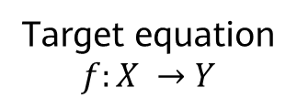
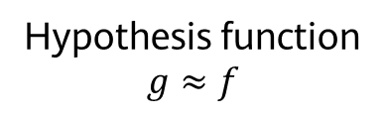
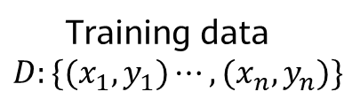
Rational Understanding of Machine Learning Algorithms
Target equation
$$f:X →Y$$
Ideal
Actual
Training data
$$D:\{(x_{1},y_{1})⋯,{(x}_{n},y_{n})\}$$
Learning algorithms
Hypothesis function
$$g≈f$$
Target function f is unknown. Learning algorithms cannot obtain a perfect function f.
Assume that hypothesis function g approximates function f, but may be different from function f.

Slide 10
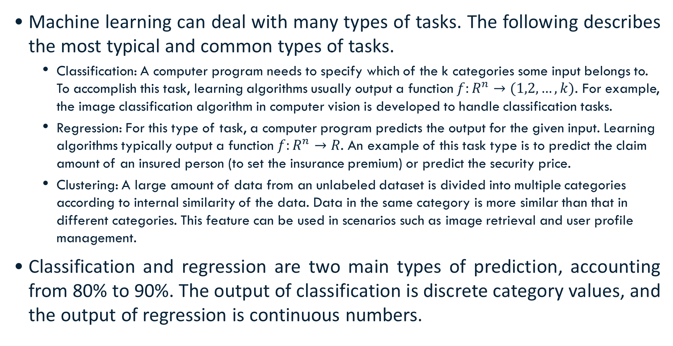
Main Problems Solved by Machine Learning
Machine learning can deal with many types of tasks. The following describes the most typical and common types of tasks.
Classification: A computer program needs to specify which of the k categories some input belongs to. To accomplish this task, learning algorithms usually output a function $f:R^{n}→(1,2,…,k)$. For example, the image classification algorithm in computer vision is developed to handle classification tasks.
Regression: For this type of task, a computer program predicts the output for the given input. Learning algorithms typically output a function $f:R^{n}→R$. An example of this task type is to predict the claim amount of an insured person (to set the insurance premium) or predict the security price.
Clustering: A large amount of data from an unlabeled dataset is divided into multiple categories according to internal similarity of the data. Data in the same category is more similar than that in different categories. This feature can be used in scenarios such as image retrieval and user profile management.
Classification and regression are two main types of prediction, accounting from 80% to 90%. The output of classification is discrete category values, and the output of regression is continuous numbers.

Slide 11
Machine Learning Definition
Machine Learning Types
Machine Learning Process
Other Key Machine Learning Methods
Common Machine Learning Algorithms
Case study

Slide 12
Machine Learning Classification
Supervised learning: Obtain an optimal model with required performance through training and learning based on the samples of known categories. Then, use the model to map all inputs to outputs and check the output for the purpose of classifying unknown data.
Unsupervised learning: For unlabeled samples, the learning algorithms directly model the input datasets. Clustering is a common form of unsupervised learning. We only need to put highly similar samples together, calculate the similarity between new samples and existing ones, and classify them by similarity.
Semi-supervised learning: In one task, a machine learning model that automatically uses a large amount of unlabeled data to assist learning directly of a small amount of labeled data.
Reinforcement learning: It is an area of machine learning concerned with how agents ought to take actions in an environment to maximize some notion of cumulative reward. The difference between reinforcement learning and supervised learning is the teacher signal. The reinforcement signal provided by the environment in reinforcement learning is used to evaluate the action (scalar signal) rather than telling the learning system how to perform correct actions.
Notes:
Supervised learning: We give a computer a bunch of choice questions (training samples) and provide standard answers. The computer tries to adjust its model parameters to make their predictions close to standard answers. In this way, the computer learns how to deal with this type of problem. Then the computer can help us reply to choice questions whose answers are not given (test samples).
Unsupervised learning: We give a computer a bunch of choice questions (training samples), but do not provide standard answers. The computer tries to analyze the relationships between these questions and classify them. It does not know the answers to these questions, but it thinks that the answers to the questions in the same category should be the same.
Semi-supervised learning: Traditional supervised learning uses a large number of labeled training samples to create a model for predicting the labels of new samples. For example, in a classification task, a label indicates the category of a sample while in a regression task, a label is a real-value output of the sample. As our data collection and storage capabilities are developing, we can easily gain a large amount of unlabeled data from many tasks. However, labeling the data is labor-consuming and time-consuming. For example, for web page recommendation, users need to label web pages they like, but only a few users are willing to spend a lot of time doing this. Then we get limited labeled web page data and a large amount of unlabeled web page data.
Reinforcement learning: We give a computer a bunch of choice questions (training samples), but do not provide standard answers. It tries to solve these questions, and we check whether the answers are correct as teachers. If the computer generates more correct answers, we offer more rewards. The computer adjusts its model parameters to make its predictions correct and obtain more rewards. Not strictly speaking, reinforcement learning can be understood as unsupervised learning plus supervised learning (unsupervised learning before supervised learning).

Slide 13
Supervised Learning
Data feature
Label
Feature 1
...
Feature n
Goal
Feature 1
...
Feature n
Supervised learning algorithm
Goal
Feature 1
...
Feature n
Goal
Weather | Temperature | Wind Speed
Sunny | Warm | Strong
Rainy | Cold | Fair
Sunny | Cold | Weak
Enjoy Sports
Yes
No
Yes

Slide 14
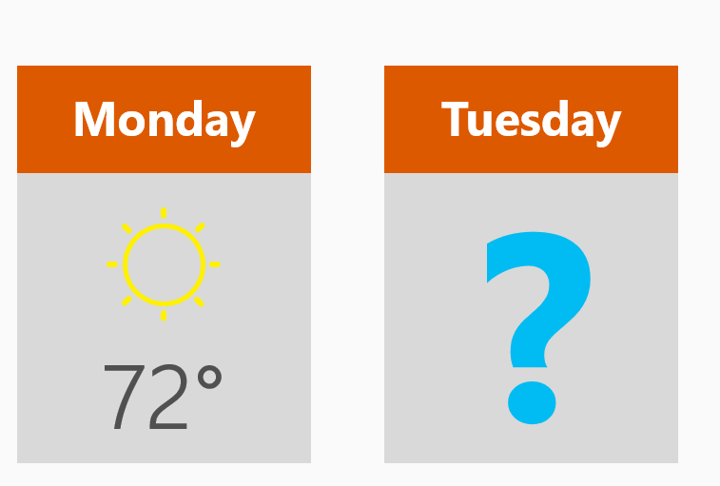
Supervised Learning - Regression Questions
Regression: reflects the features of attribute values of samples in a sample dataset. The dependency between attribute values is discovered by expressing the relationship of sample mapping through functions.
How much will I benefit from the stock next week?
What's the temperature on Tuesday?

Slide 15
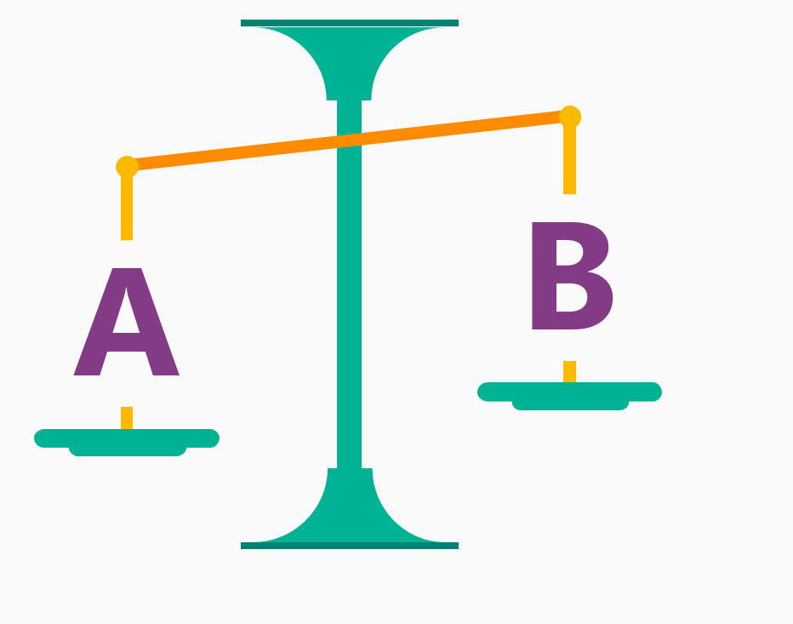
Supervised Learning - Classification Questions
Classification: maps samples in a sample dataset to a specified category by using a classification model.
Will there be a traffic jam on XX road during the morning rush hour tomorrow?
Which method is more attractive to customers: 5 yuan voucher or 25% off?

Slide 16
Unsupervised Learning
Data Feature
Feature 1
...
Feature n
Internal similarity
Feature 1
...
Feature n
Unsupervised learning algorithm
Feature 1
...
Feature n
Monthly Consumption | Commodity | Consumption Time
1000–2000 | Badminton racket | 6:00–12:00
500–1000 | Basketball | 18:00–24:00
1000–2000 | Game console | 00:00–6:00
Category
Cluster 1
Cluster 2

Slide 17
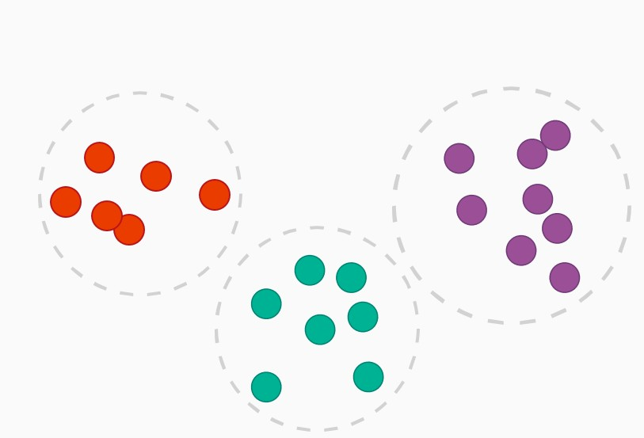
Unsupervised Learning - Clustering Questions
Clustering: classifies samples in a sample dataset into several categories based on the clustering model. The similarity of samples belonging to the same category is high.
Which audiences like to watch movies of the same subject?
Which of these components are damaged in a similar way?

Slide 18
Semi-Supervised Learning
Data Feature
Label
Feature 1
...
Feature n
Goal
Feature 1
...
Feature n
Semi-supervised learning algorithms
Unknown
Feature 1
...
Feature n
Unknown
Weather | Temperature | Wind Speed
Sunny | Warm | Strong
Rainy | Cold | Fair
Sunny | Cold | Weak
Enjoy Sports
Yes
/
/

Slide 19



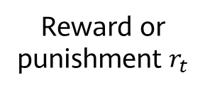

Reinforcement Learning
The model perceives the environment, takes actions, and makes adjustments and choices based on the status and award or punishment.
Model
Status $s_{t}$
Reward or punishment $r_{t}$
Action $a_{t}$
$$r_{t+1}$$
$$s_{t+1}$$
Environment
Notes:
Reinforcement learning uses a series of actions to maximize the reward function to learn models.
Both good and bad behaviors can help reinforcement learning in model learning.
For example, autonomous vehicles learn by continuously interacting with the environment.

Slide 20
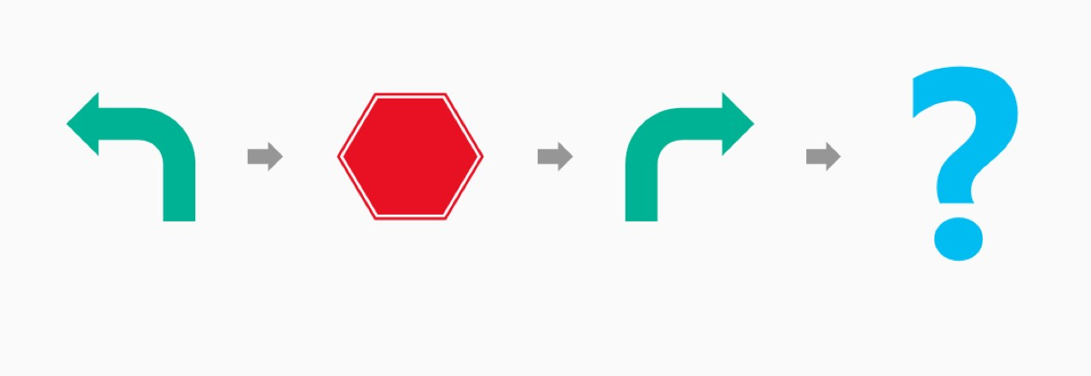
Reinforcement Learning - Best Behavior
Reinforcement learning: always looks for best behaviors. Reinforcement learning is targeted at machines or robots.
Autopilot: Should it brake or accelerate when the yellow light starts to flash?
Cleaning robot: Should it keep working or go back for charging?

Slide 21
Machine learning algorithm
Machine Learning Classification
Machine Learning Process
Other Key Machine Learning Methods
Common Machine Learning Algorithms
Case study

Slide 22
Machine Learning Process
Feature extraction and selection
Model evaluation
Model deployment and integration
Data collection
Data cleansing
Model training
Feedback and iteration

Slide 23
Basic Machine Learning Concept — Dataset
Dataset: a collection of data used in machine learning tasks. Each data record is called a sample. Events or attributes that reflect the performance or nature of a sample in a particular aspect are called features.
Training set: a dataset used in the training process, where each sample is referred to as a training sample. The process of creating a model from data is called learning (training).
Test set: Testing refers to the process of using the model obtained after learning for prediction. The dataset used is called a test set, and each sample is called a test sample.

Slide 24
Checking Data Overview
Typical dataset form
Feature 1
Feature 2
Feature 3
Label
No. | Area | School Districts | Direction | House Price
1 | 100 | 8 | South | 1000
2 | 120 | 9 | Southwest | 1300
3 | 60 | 6 | North | 700
4 | 80 | 9 | Southeast | 1100
5 | 95 | 3 | South | 850
Training set
Test set

Slide 25
Importance of Data Processing
Data is crucial to models. It is the ceiling of model capabilities. Without good data, there is no good model.
Data preprocessing
Data cleansing
Data normalization
Fill in missing values, and detect and eliminate causes of dataset exceptions.
Normalize data to reduce noise and improve model accuracy.
Data dimension reduction
Simplify data attributes to avoid dimension explosion.

Slide 26
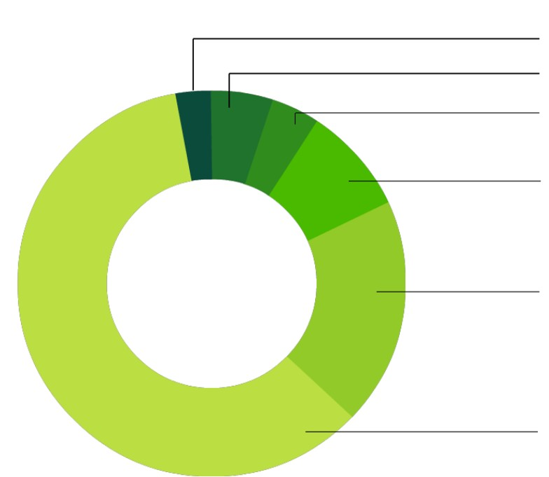

Workload of Data Cleansing
Statistics on data scientists' work in machine learning
3% Remodeling training datasets
5% Others
4% Optimizing models
9% Mining modes from data
19% Collecting datasets
60% Cleansing and sorting data
CrowdFlower Data Science Report 2016

Slide 27
Data Cleansing
Most machine learning models process features, which are usually numeric representations of input variables that can be used in the model.
In most cases, the collected data can be used by algorithms only after being preprocessed. The preprocessing operations include the following:
Data filtering
Processing of lost data
Processing of possible exceptions, errors, or abnormal values
Combination of data from multiple data sources
Data consolidation

Slide 28
Dirty Data (1)
Generally, real data may have some quality problems.
Incompleteness: contains missing values or the data that lacks attributes
Noise: contains incorrect records or exceptions.
Inconsistency: contains inconsistent records.

Slide 29
Dirty Data (2)
# | Id | Name | Birthday | Gender | IsTeacher | #Students | Country | City
1 | 111 | John | 31/12/1990 | M | 0 | 0 | Ireland | Dublin
2 | 222 | Mery | 15/10/1978 | F | 1 | 15 | Iceland
3 | 333 | Alice | 19/04/2000 | F | 0 | 0 | Spain | Madrid
4 | 444 | Mark | 01/11/1997 | M | 0 | 0 | France | Paris
5 | 555 | Alex | 15/03/2000 | A | 1 | 23 | Germany | Berlin
6 | 555 | Peter | 1983-12-01 | M | 1 | 10 | Italy | Rome
7 | 777 | Calvin | 05/05/1995 | M | 0 | 0 | Italy | Italy
8 | 888 | Roxane | 03/08/1948 | F | 0 | 0 | Portugal | Lisbon
9 | 999 | Anne | 05/09/1992 | F | 0 | 5 | Switzerland | Geneva
10 | 101010 | Paul | 14/11/1992 | M | 1 | 26 | Ytali | Rome
Missing value
Invalid value
Value that should be in another column
Invalid duplicate item
Misspelling
Incorrect format
Attribute dependency

Slide 30
Data Conversion
After being preprocessed, the data needs to be converted into a representation form suitable for the machine learning model. Common data conversion forms include the following:
With respect to classification, category data is encoded into a corresponding numerical representation.
Value data is converted to category data to reduce the value of variables (for age segmentation).
Other data
In the text, the word is converted into a word vector through word embedding (generally using the word2vec model, BERT model, etc).
Process image data (color space, grayscale, geometric change, Haar feature, and image enhancement)
Feature engineering
Normalize features to ensure the same value ranges for input variables of the same model.
Feature expansion: Combine or convert existing variables to generate new features, such as the average.

Slide 31
Necessity of Feature Selection
Generally, a dataset has many features, some of which may be redundant or irrelevant to the value to be predicted.
Feature selection is necessary in the following aspects:
Simplify models to make them easy for users to interpret
Reduce the training time
Avoid dimension explosion
Improve model generalization and avoid overfitting

Slide 32
Feature Selection Methods - Filter
Filter methods are independent of the model during feature selection.
By evaluating the correlation between each feature and the target attribute, these methods use a statistical measure to assign a value to each feature. Features are then sorted by score, which is helpful for preserving or eliminating specific features.
Common methods
Pearson correlation coefficient
Chi-square coefficient
Mutual information
Limitations
The filter method tends to select redundant variables as the relationship between features is not considered.
Traverse all features
Select the optimal feature subset
Train models
Evaluate the performance
Procedure of a filter method

Slide 33
Feature Selection Methods - Wrapper
Wrapper methods use a prediction model to score feature subsets.
Wrapper methods consider feature selection as a search issue for which different combinations are evaluated and compared. A predictive model is used to evaluate a combination of features and assign a score based on model accuracy.
Common methods
Recursive feature elimination (RFE)
Limitations
Wrapper methods train a new model for each subset, resulting in a huge number of computations.
A feature set with the best performance is usually provided for a specific type of model.
Select the optimal feature subset
Traverse all features
Generate a feature subset
Train models
Evaluate models
Procedure of a wrapper method

Slide 34
Feature Selection Methods - Embedded
Embedded methods consider feature selection as a part of model construction.
The most common type of embedded feature selection method is the regularization method.
Regularization methods are also called penalization methods that introduce additional constraints into the optimization of a predictive algorithm that bias the model toward lower complexity and reduce the number of features.
Common methods
Lasso regression
Ridge regression
Select the optimal feature subset
Traverse all features
Generate a feature subset
Train models
+ Evaluate the effect
Procedure of an embedded method
Notes:
The penalty attribute of the model is highlighted, which is used to eliminate unimportant features.

Slide 35
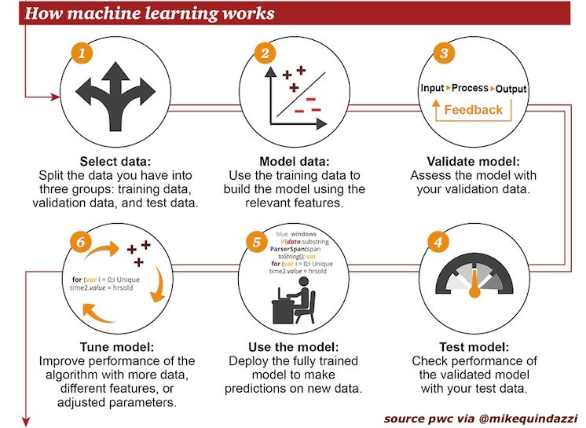
Overall Procedure of Building a Model
Model Building Procedure
1 2 3
Data splitting:
Divide data into training sets, test sets, and validation sets.
Model training:
Use data that has been cleaned up and feature engineering to train a model.
Model verification:
Use validation sets to validate the model validity.
6
5
4
Model fine-tuning:
Continuously tune the model based on the actual data of a service scenario.
Model deployment:
Deploy the model in an actual production scenario.
Model test:
Use test data to evaluate the generalization capability of the model in a real environment.
Notes:
After data cleansing and feature extraction, we need to start building the model. The general procedure for building a model is shown above (supervised learning).

Slide 36

Examples of Supervised Learning - Learning Phase
Use the classification model to predict whether a person is a basketball player.
Feature (attribute)
Target
Service data
Name | City | Age | Label
Mike | Miami | 42 | yes
Jerry | New York | 32 | no
Bryan | Orlando | 18 | no
Patricia | Miami | 45 | yes
Elodie | Phoenix | 35 | no
Remy | Chicago | 72 | yes
John | New York | 48 | yes
Training set
The model searches for the relationship between features and targets.
(Cleansed features and tags)
Splitting
Task: Use a classification model to predict whether a person is a basketball player under a specific feature.
Test set
Use new data to verify the model validity.
Model training
Each feature or a combination of several features can provide a basis for a model to make a judgment.
Notes:
Model example

Slide 37
Examples of Supervised Learning - Prediction Phase
Name | City | Age | Label
Marine | Miami | 45 | ?
Julien | Miami | 52 | ?
Fred | Orlando | 20 | ?
Michelle | Boston | 34 | ?
Nicolas | Phoenix | 90 | ?
Unknown data
Recent data, it is not known whether the people are basketball players.
New data
IF city = Miami → Probability = +0.7
IF city= Orlando → Probability = +0.2
IF age > 42 → Probability = +0.05*age + 0.06
IF age ≤ 42 → Probability = +0.01*age + 0.02
Application model
Name | City | Age | Prediction
Marine | Miami | 45 | 0.3
Julien | Miami | 52 | 0.9
Fred | Orlando | 20 | 0.6
Michelle | Boston | 34 | 0.5
Nicolas | Phoenix | 90 | 0.4
New data
Possibility prediction
Apply the model to the new data to predict whether the customer will change the supplier.
Prediction data
Notes:
Model example
The model here can be considered similar to the decision tree model.

Slide 38

What Is a Good Model?
Generalization capability
Can it accurately predict the actual service data?
Interpretability
Is the prediction result easy to interpret?
Prediction speed
How long does it take to predict each piece of data?
Practicability
Is the prediction rate still acceptable when the service volume increases with a huge data volume?
Notes:
Which factors are used to determine a model?
The last three are engineering factors. The generalization capability is the most important factor.

Slide 39
Model Validity (1)
Generalization capability: The goal of machine learning is that the model obtained after learning should perform well on new samples, not just on samples used for training. The capability of applying a model to new samples is called generalization or robustness.
Error: difference between the sample result predicted by the model obtained after learning and the actual sample result.
Training error: error that you get when you run the model on the training data.
Generalization error: error that you get when you run the model on new samples. Obviously, we prefer a model with a smaller generalization error.
Underfitting: occurs when the model or the algorithm does not fit the data well enough.
Overfitting: occurs when the training error of the model obtained after learning is small but the generalization error is large (poor generalization capability).
Notes:
Once the form of a problem's hypothesis is given, all possible functions constitute a space, which is hypothesis space. The problem of machine learning is searching for a suitable fitting function in a hypothesis space.
Overfitting: It occurs frequently in complex mathematical models. To prevent overfitting, we can simplify mathematical models, end training before overfitting, or use dropout/weight decay methods.
Underfitting: It occurs if the mathematical model is too simple or the training time is too short. To solve the underfitting problem, use a more complex model or extend the training time.

Slide 40
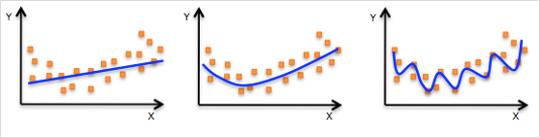
Model Validity (2)
Model capacity: model's capability of fitting functions, which is also called model complexity.
When the capacity suits the task complexity and the amount of training data provided, the algorithm effect is usually optimal.
Models with insufficient capacity cannot solve complex tasks and underfitting may occur.
A high-capacity model can solve complex tasks, but overfitting may occur if the capacity is higher than that required by a task.
Underfitting
Not all features are learned.
Good fitting
Overfitting
Noises are learned.
Notes:
The effective capacity is restricted by algorithms, parameters, and regularization.

Slide 41
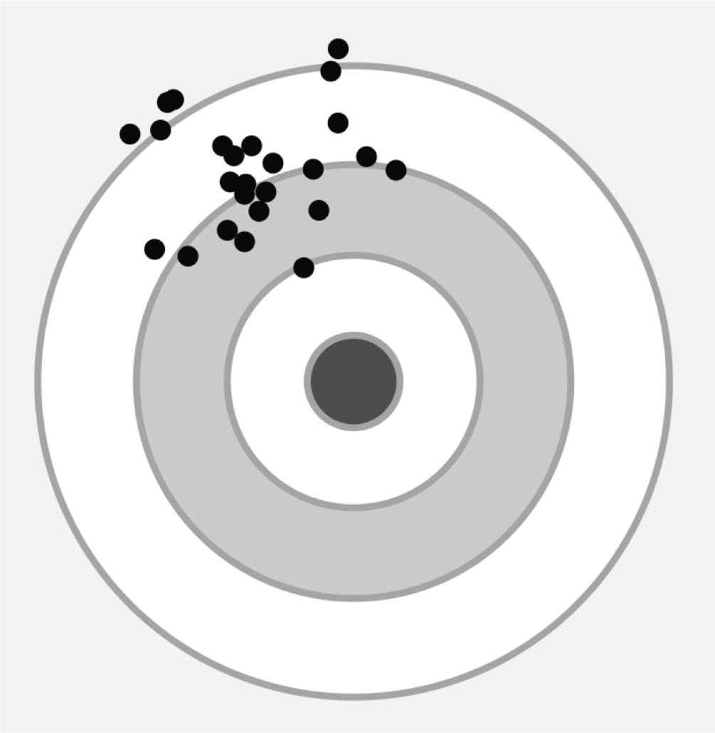
Overfitting Cause — Error
Total error of final prediction = Bias2 + Variance + Irreducible error
Generally, the prediction error can be divided into two types:
Error caused by "bias"
Error caused by "variance"
Variance:
Offset of the prediction result from the average value
Error caused by the model's sensitivity to small fluctuations in the training set
Bias:
Difference between the expected (or average) prediction value and the correct value we are trying to predict.
Variance
Bias
Notes:
About the unresolvable error
Theoretically, if there is infinite amount of data and a perfect model, the error can be eliminated.
Actually, all models are imperfect, and our data volume is limited.

Slide 42
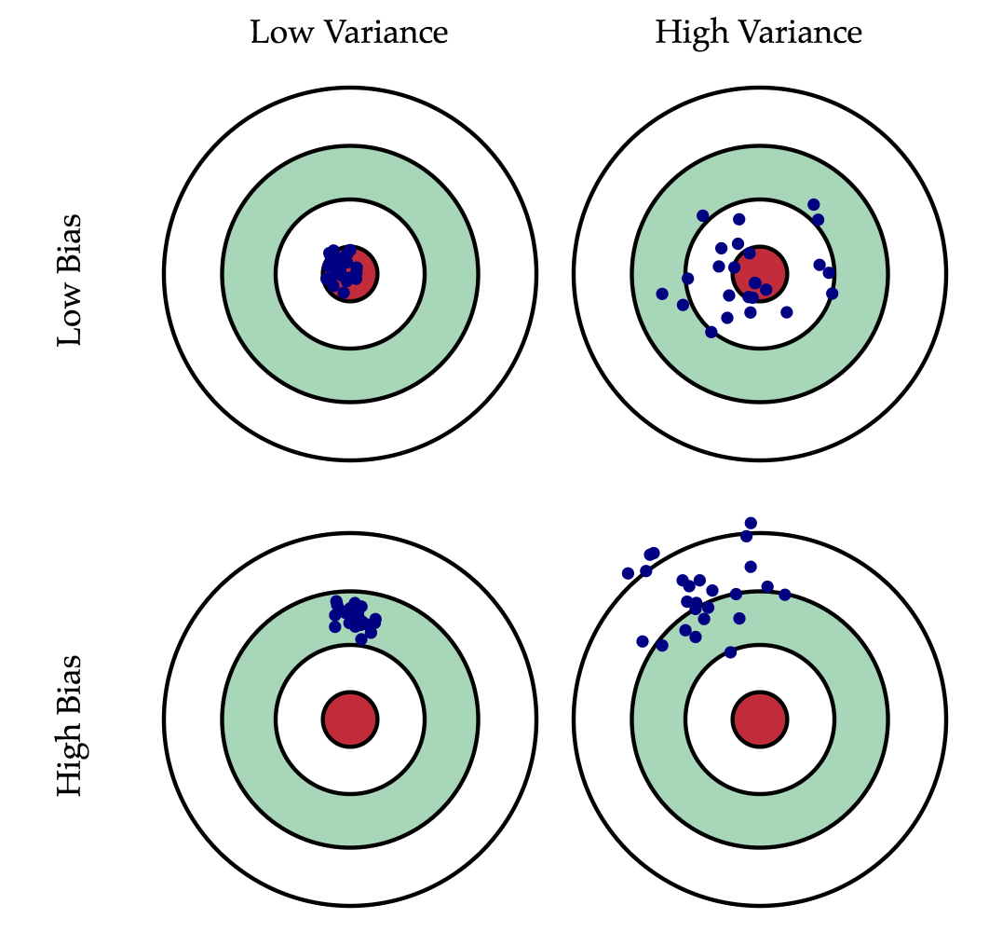
Variance and Bias
Combinations of variance and bias are as follows:
Low bias & low variance –> Good model
Low bias & high variance
High bias & low variance
High bias & high variance –> Poor model
Ideally, we want a model that can accurately capture the rules in the training data and summarize the invisible data (new data). However, it is usually impossible for the model to complete both tasks at the same time.

Slide 43
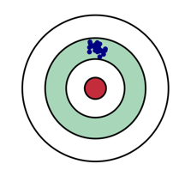
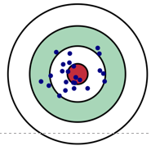
Model Complexity and Error
As the model complexity increases, the training error decreases.
As the model complexity increases, the test error decreases to a certain point and then increases in the reverse direction, forming a convex curve.
High bias & low variance
Low bias & high variance
Testing error
Error
Training error
Model Complexity

Slide 44

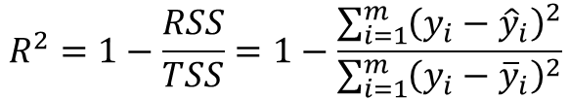
Machine Learning Performance Evaluation - Regression
The closer the Mean Absolute Error (MAE) is to 0, the better the model can fit the training data.
$$MAE=\frac{1}{m}\sum_{i=1}^{m}{\left|y_{i}−{\hat{y}}_{i}\right|}$$
Mean Square Error (MSE)
$$MSE=\frac{1}{m}\sum_{i=1}^{m}{{\left(y_{i}−{\hat{y}}_{i}\right)}^{2}}$$
The value range of R² is (–∞, 1]. A larger value indicates that the model can better fit the training data. TSS indicates the difference between samples. RSS indicates the difference between the predicted value and sample value.
$$R^{2}=1−\frac{RSS}{TSS}=1−\frac{\sum_{i=1}^{m}{{\left(y_{i}−{\hat{y}}_{i}\right)}^{2}}}{\sum_{i=1}^{m}{{\left(y_{i}−{\overline{y}}_{i}\right)}^{2}}}$$

Slide 45

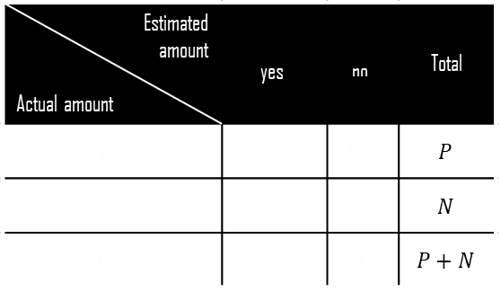
Machine Learning Performance Evaluation - Classification (1)
Estimated amount Actual amount | $$\text{yes}$$ | $$\text{no}$$ | Total
yes | $$TP$$ | $$FN$$ | $$P$$
no | $$FP$$ | $$TN$$ | $$N$$
Total | $$P^{′}$$ | $$N^{′}$$ | $$P+N$$
Terms and definitions:
$P$: positive, indicating the number of real positive cases in the data.
$N$: negative, indicating the number of real negative cases in the data.
$TP$: true positive, indicating the number of positive cases that are correctly classified by the classifier.
$TN$: true negative, indicating the number of negative cases that are correctly classified by the classifier.
$FP$: false positive, indicating the number of positive cases that are incorrectly classified by the classifier.
$FN$: false negative, indicating the number of negative cases that are incorrectly classified by the classifier.
Confusion matrix: at least an $m×m$ table. $CM_{i,j}$ of the first $m$ rows and $m$ columns indicates the number of cases that actually belong to class $i$ but are classified into class $j$ by the classifier.
Ideally, for a high accuracy classifier, most prediction values should be located in the diagonal from $CM_{1,1}$ to $CM_{m,m}$ of the table while values outside the diagonal are 0 or close to 0. That is, $FP$ and $FP$ are close to 0.
Confusion matrix

Slide 46
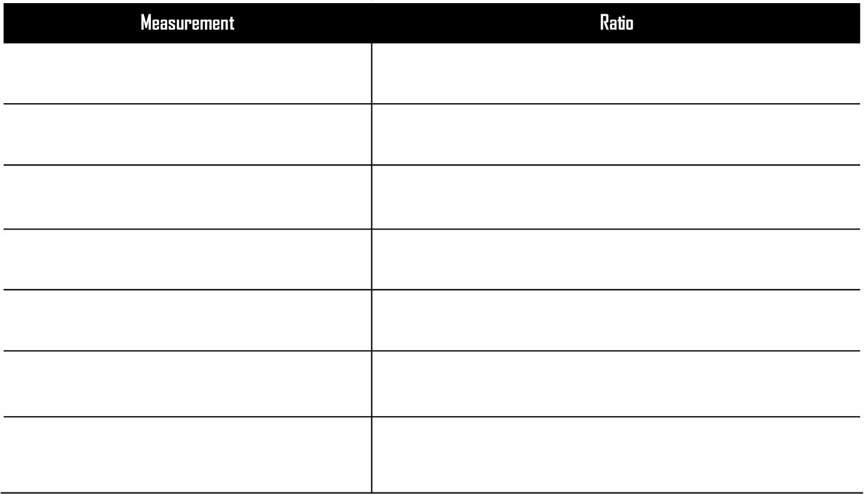
Machine Learning Performance Evaluation - Classification (2)
Measurement | Ratio
Accuracy and recognition rate | $$\frac{TP+TN}{P+N}$$
Error rate and misclassification rate | $$\frac{FP+FN}{P+N}$$
Sensitivity, true positive rate, and recall | $$\frac{TP}{P}$$
Specificity and true negative rate | $$\frac{TN}{N}$$
Precision | $$\frac{TP}{TP+FP}$$
$F_{1}$, harmonic mean of the recall rate and precision | $$\frac{2×precision×recall}{precision+recall}$$
$F_{β}$, where $β$ is a non-negative real number | $$\frac{(1+β^{2})×precision×recall}{β^{2}×precision+recall}$$

Slide 47
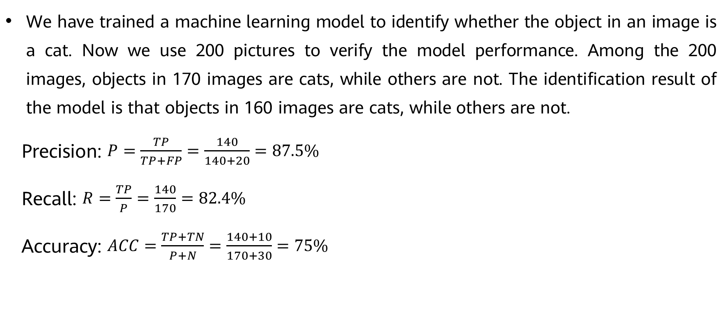
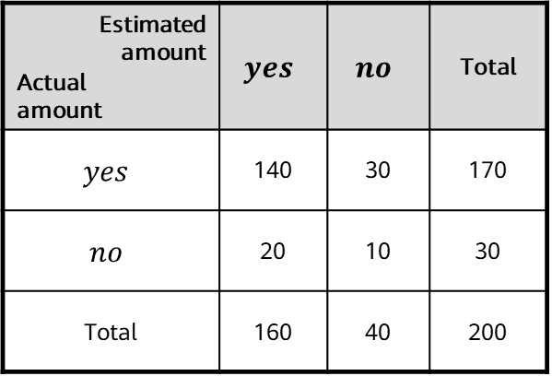
Example of Machine Learning Performance Evaluation
We have trained a machine learning model to identify whether the object in an image is a cat. Now we use 200 pictures to verify the model performance. Among the 200 images, objects in 170 images are cats, while others are not. The identification result of the model is that objects in 160 images are cats, while others are not.
Precision: $P=\frac{TP}{TP+FP}=\frac{140}{140+20}=87.5\%$
Recall: $R=\frac{TP}{P}=\frac{140}{170}=82.4\%$
Accuracy: $ACC=\frac{TP+TN}{P+N}=\frac{140+10}{170+30}=75\%$
Estimated amount Actual amount | $$yes$$ | $$no$$ | Total
$$yes$$ | 140 | 30 | 170
$$no$$ | 20 | 10 | 30
Total | 160 | 40 | 200

Slide 48
Machine Learning Definition
Machine Learning Types
Machine Learning Process
Other Key Machine Learning Methods
Common Machine Learning Algorithms
Case study

Slide 49
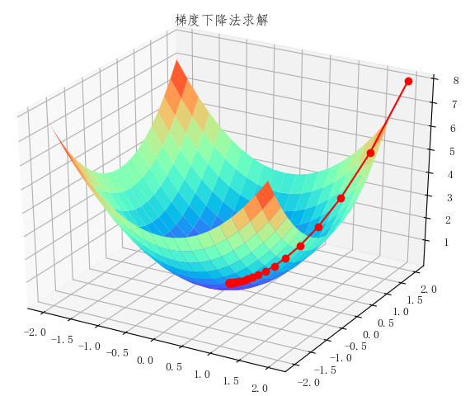
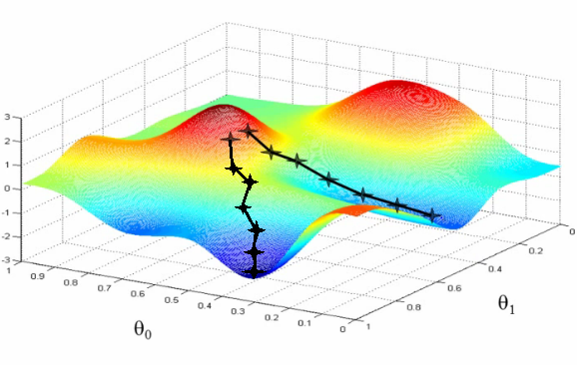
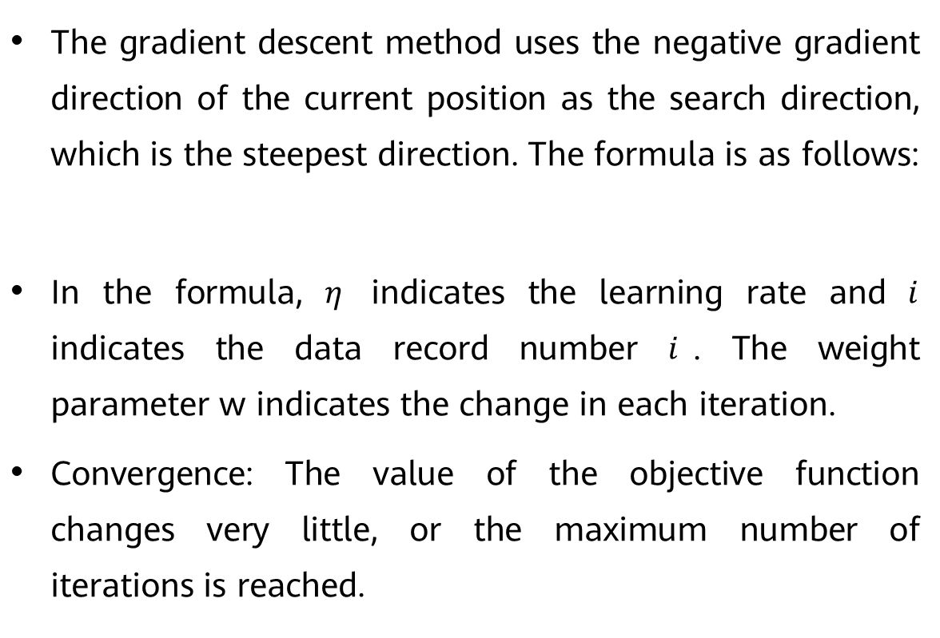
Machine Learning Training Method - Gradient Descent (1)
The gradient descent method uses the negative gradient direction of the current position as the search direction, which is the steepest direction. The formula is as follows:
In the formula, $η$ indicates the learning rate and $i$ indicates the data record number $i$. The weight parameter w indicates the change in each iteration.
Convergence: The value of the objective function changes very little, or the maximum number of iterations is reached.
Cost surface

Slide 50
Machine Learning Training Method - Gradient Descent (2)
Batch Gradient Descent (BGD) uses the samples (m in total) in all datasets to update the weight parameter based on the gradient value at the current point.
Stochastic Gradient Descent (SGD) randomly selects a sample in a dataset to update the weight parameter based on the gradient value at the current point.
Mini-Batch Gradient Descent (MBGD) combines the features of BGD and SGD and selects the gradients of n samples in a dataset to update the weight parameter.

Slide 51
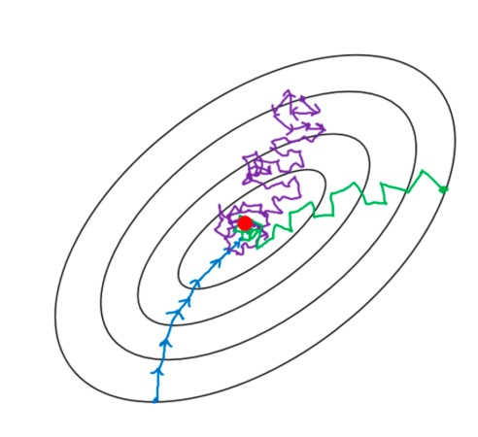
Machine Learning Training Method - Gradient Descent (3)
Comparison of three gradient descent methods
In the SGD, samples selected for each training are stochastic. Such instability causes the loss function to be unstable or even causes reverse displacement when the loss function decreases to the lowest point.
BGD has the highest stability but consumes too many computing resources. MBGD is a method that balances SGD and BGD.
BGD
Uses all training samples for training each time.
SGD
Uses one training sample for training each time.
MBGD
Uses a certain number of training samples for training each time.
Notes:
Reverse displacement is caused by noise data from datasets.

Slide 52
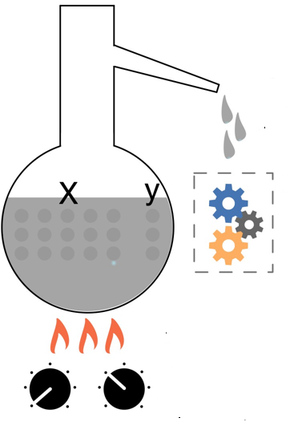
Parameters and Hyperparameters in Models
The model contains not only parameters but also hyperparameters. The purpose is to enable the model to learn the optimal parameters.
Parameters are automatically learned by models.
Hyperparameters are manually set.
Model parameters are "distilled" from data.
Model
Training
Use hyperparameters to control training.

Slide 53
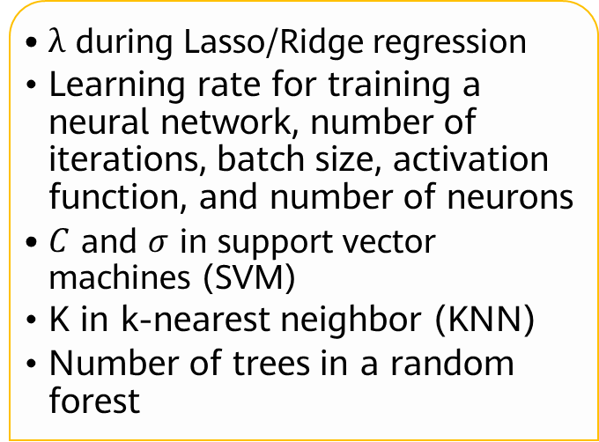
Hyperparameters of a Model
Often used in model parameter estimation processes.
Often specified by the practitioner.
Can often be set using heuristics.
Often tuned for a given predictive modeling problem.
$λ$ during Lasso/Ridge regression
Learning rate for training a neural network, number of iterations, batch size, activation function, and number of neurons
$C$ and $σ$ in support vector machines (SVM)
K in k-nearest neighbor (KNN)
Number of trees in a random forest
Model hyperparameters are external configurations of models.
Common model hyperparameters
Notes:
Parameters are a part of a model that is learned from historical training data and key to machine learning algorithms. They have the following features:
They are required by a model to make predictions.
Their values define the model functions.
They are obtained by data estimation or data learning.
They are often not set manually by the practitioner.
They are often saved as a part of the learned model.
Examples:
Weights in an artificial neural network
Support vectors in a support vector machine
Coefficients in linear regression or logistic regression

Slide 54
Hyperparameter Search Procedure and Method
Procedure for searching hyperparameters
Dividing a dataset into a training set, validation set, and test set.
Optimizing the model parameters using the training set based on the model performance indicators.
Searching for the model hyper-parameters using the validation set based on the model performance indicators.
Perform step 2 and step 3 alternately. Finally, determine the model parameters and hyperparameters and assess the model using the test set.
Search algorithm (step 3)
Grid search
Random search
Heuristic intelligent search
Bayesian search

Slide 55
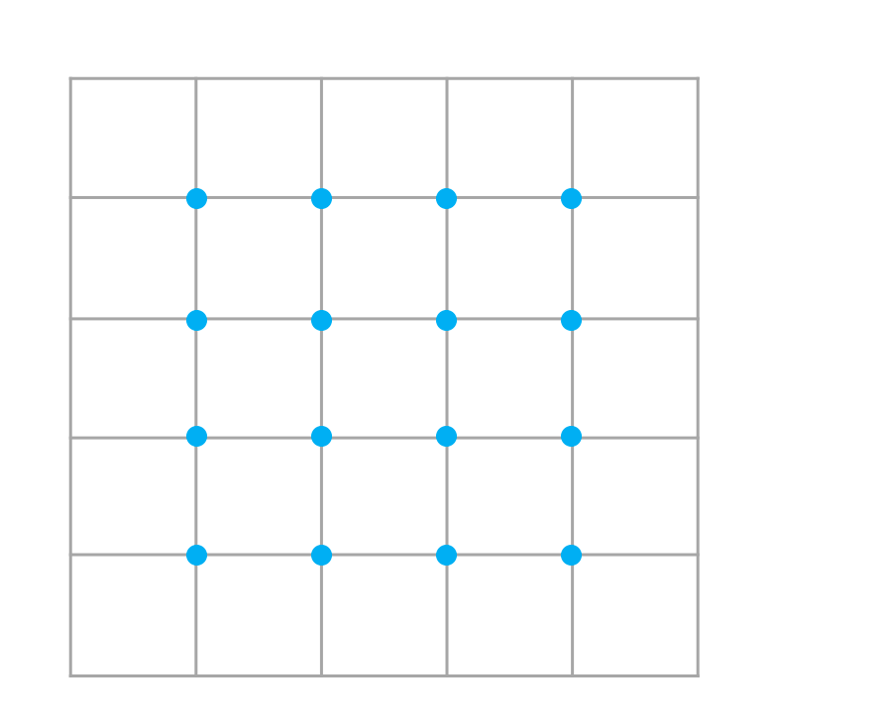
Hyperparameter Searching Method - Grid Search
Grid search attempts to exhaustively search all possible hyperparameter combinations to form a hyperparameter value grid.
In practice, the range of hyperparameter values to search is specified manually.
Grid search is an expensive and time-consuming method.
This method works well when the number of hyperparameters is relatively small. Therefore, it is applicable to generally machine learning algorithms but inapplicable to neural networks (see the deep learning part).
Grid search
Hyperparameter 1
5
4
3
2
1
0
1
2
3
4
5
Hyperparameter 2

Slide 56
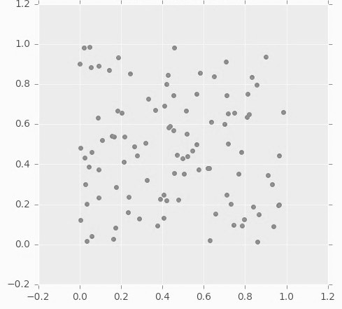
Hyperparameter Searching Method - Random Search
When the hyperparameter search space is large, random search is better than grid search.
In random search, each setting is sampled from the distribution of possible parameter values, in an attempt to find the best subset of hyperparameters.
Note:
Search is performed within a coarse range, which then will be narrowed based on where the best result appears.
Some hyperparameters are more important than others, and the search deviation will be affected during random search.
Random search
Parameter 1
Parameter 2

Slide 57
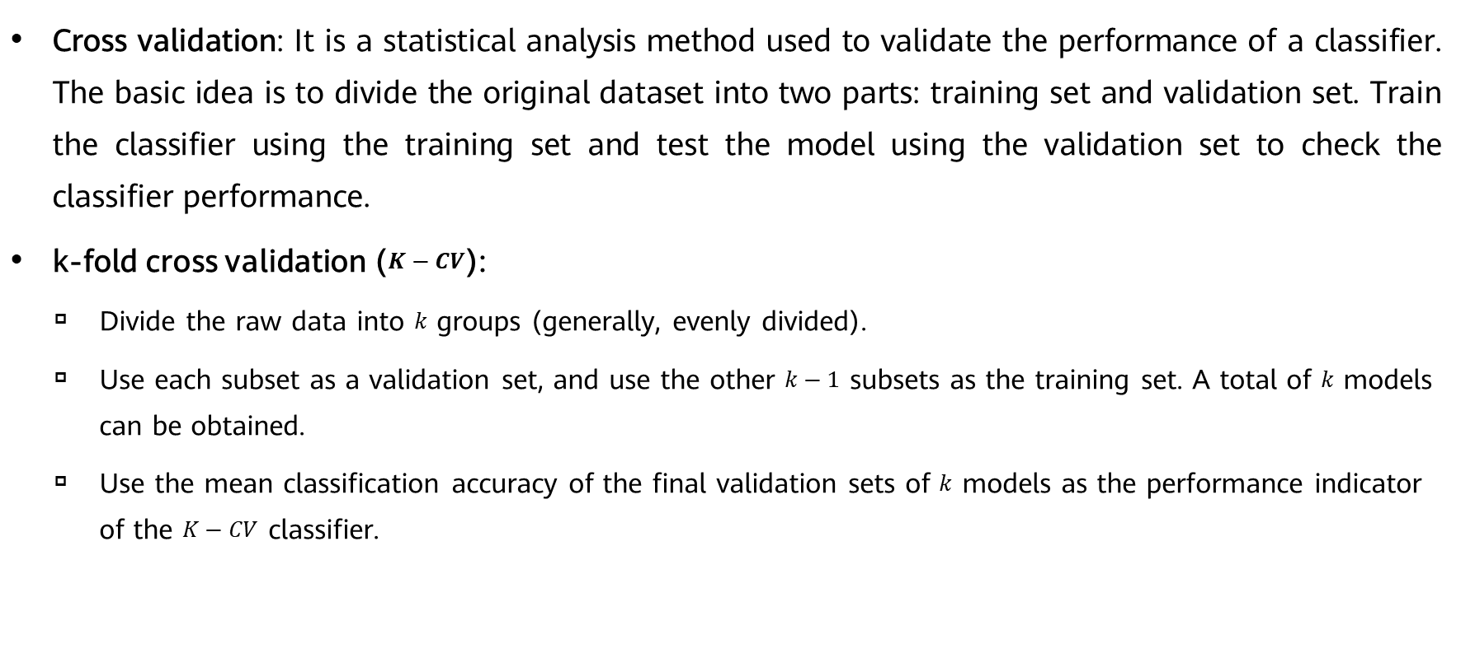
Cross Validation (1)
Cross validation: It is a statistical analysis method used to validate the performance of a classifier. The basic idea is to divide the original dataset into two parts: training set and validation set. Train the classifier using the training set and test the model using the validation set to check the classifier performance.
k-fold cross validation ($K−CV$):
Divide the raw data into $k$ groups (generally, evenly divided).
Use each subset as a validation set, and use the other $k−1$ subsets as the training set. A total of $k$ models can be obtained.
Use the mean classification accuracy of the final validation sets of $k$ models as the performance indicator of the $K−CV$ classifier.
Notes:
Dividing a dataset into a ﬁxed training set and a ﬁxed test set can be problematic if the error of the test set is small. A small test set implies statistical uncertainty around the estimated mean test error, making it difficult to claim that algorithm $A$ works better than algorithm $B$ on the given task. When the dataset has hundreds of thousands of samples or more, this is not a serious problem. When the dataset is too small, alternative procedures enable one to use all the samples in the estimation of the mean test error, at the price of increased computational workload.
K-CV: Generally, the value of $k$ is greater than or equal to 2. In practice, the value is greater than or equal to 3. The value 2 is used only when the original dataset is small. $K−CV$ can effectively avoid over-learning and under-learning, and the final result is also persuasive.

Slide 58
Cross Validation (2)
Entire dataset
Training set
Test set
Training set
Validation set
Test set
Note: The K value in K-fold cross validation is also a hyperparameter.

Slide 59

Thanks
Any questions?

